Slide 1

Deforestation Detection System with
CNN
Protect our forests using CNN for real-time monitoring and rapid response.
By 2200049154

Slide 2
ABSTRACT:
The world loses up to 10 million acres of old-growth rain forests each year, much of it due to illegal logging. Deforestation from this and other causes accounts for about 10% of global carbon emissions. The project aims to convert thousands of discarded smart modules into solar-powered listening modules and position them throughout the Forest to transmit alerts in response to the sounds of chainsaws and truck engines. Audio classification can be performed by converting audio streams into spectrograms, which provide visual representations of spectrums of frequencies as they vary over time, and classifying the spectrograms using convolutional neural networks(CNNs)

Slide 3
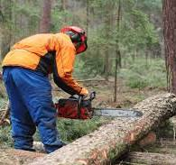


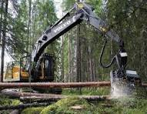
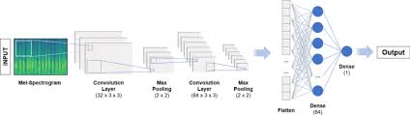
BLOCK DIAGRAM
SINGLE BOARD COMPUTER
/pi
microphone
ALERTS
SOUNDS
CNN

Slide 4
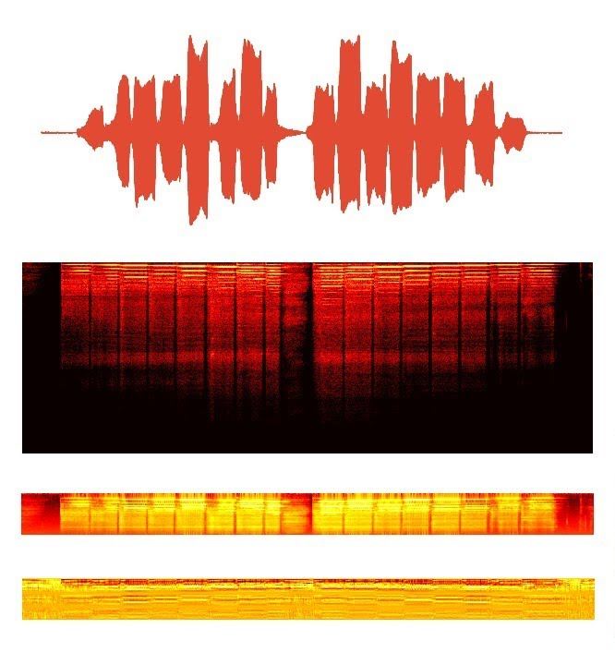



Implementation
Training
Feed AI with audio samples of chainsaws and engines.
Deployment and Detection
Real-time analysis of audio streams.
Alert Triggering
Immediate notification when suspicious sounds are identified.

Slide 5

Transmitting Alerts
1
2
Real-Time
Fast Response
Immediate notification to authorities.
Timely intervention to stop deforestation activities.

Slide 6

DATA COLLECTION
Types of Audio Data
Background Sounds: Natural sounds of the Forest.
Engine Sounds: Engine sounds from the JCB`s and heavy vehicles.
Chain saw sounds :Sounds from the chainsaw machine.
Storms sounds: Sounds of rains and stroms and thunders.
Collected 100 samples of every class

Slide 7
DATA PROCESSING

Slide 8
TRAINING & TESTING CNN MODEL

Slide 9
DEPLOYMENT & PIPELINING
DEPLOYEMNT OPTIONS:
1.SBC(Raspberrypi)
2.ESP32

